Slide 1

Brain tumor detection using Convolution neural network and kreas library
Jayshil Patel (18EC068)
Josh Patel(18EC070)
Shubham Barve(18EC007)

Slide 2
Need for an alternative
Time consumption
Average cost
Availability
Accuracy

Slide 3
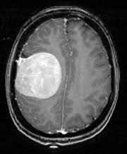
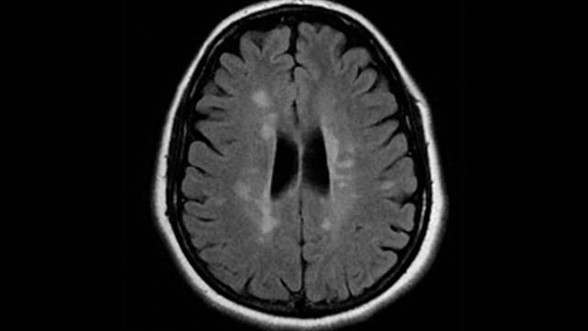
Any guess which of the following have brain tumour

Slide 4
Gathering resources
Number of images and accuracy
Correct incides
Authenticity of resources
Dorsal or ventral view

Slide 5
Why to choose Python over MATLAB?
Wider availability of resources
Better help and bigger community
Better packages
Availability of google collab
Hence, platform independent

Slide 6
Reason for choosing google collab
Readily available libraries like tensorflow and keras
Platform independent
Only browser required
No prior installation required

Slide 7
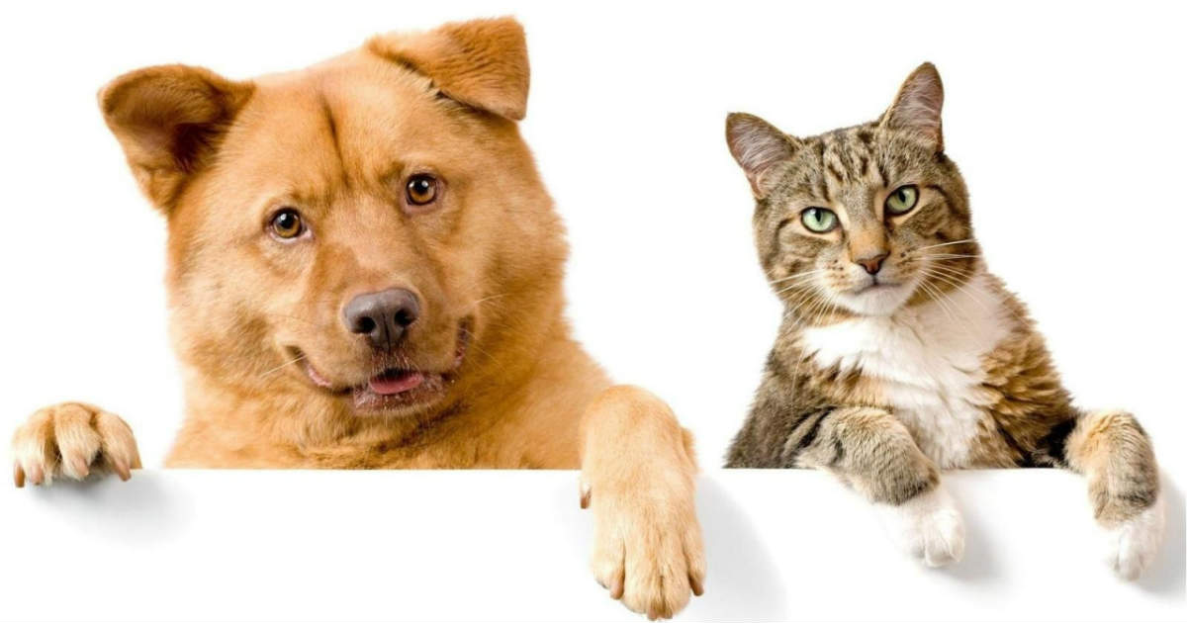
How do we distinguish between cat and dog?

Slide 8
Example of convolution

Slide 9
How can we search through an image for special features?
[1,3,5,7,8,9]
How can we search for a particular number ?

Slide 10
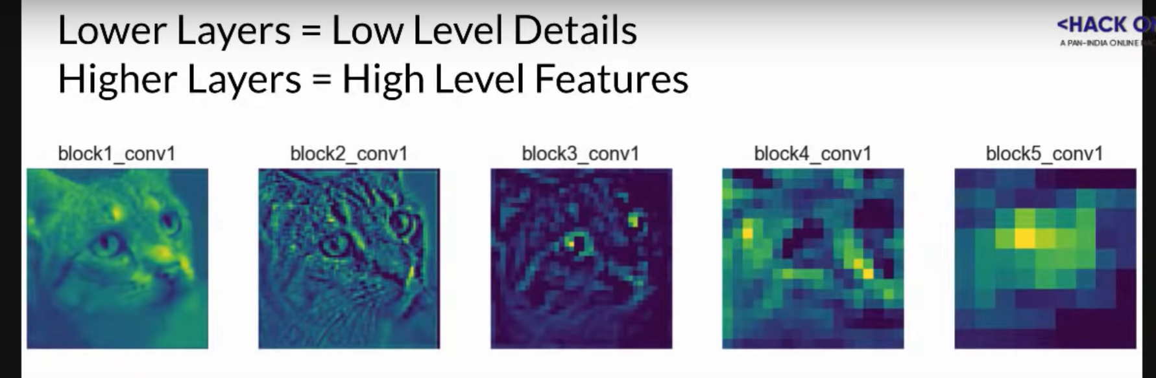
What are layers in the neural network?

Slide 11
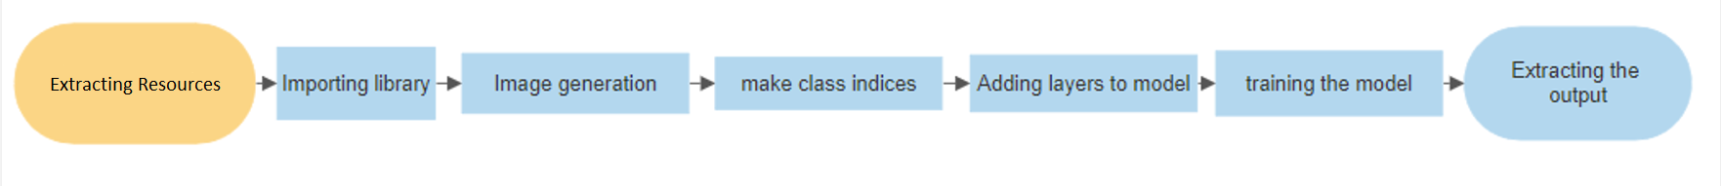
Software flow diagram

